Slide 1



Graphing
Data

Slide 2
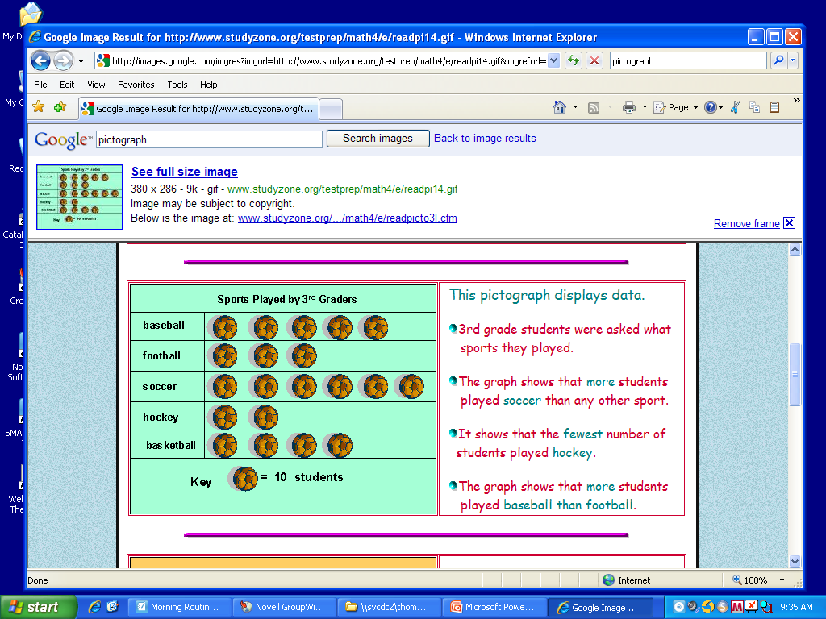
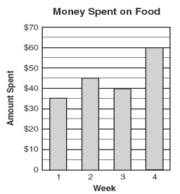
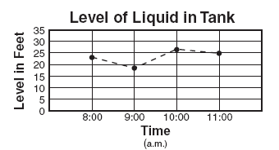
Graphs show information we need. They can make it easy to read.
There are many types of graphs. They include:
Pictographs
Bar Graphs
Line Graphs

Slide 3
Pictograph
Pictographs display data
Every pictograph has a title, pictures or symbols, key, and labels
The title of this pictograph tells you about the sports played by 3rd graders.
This is the key. It tells you what the symbols in the graph represent.

Slide 4
How many students played baseball according to this pictograph?
5
10
50

Slide 5
Which sport did the fewest number of students play?
baseball
football
hockey
basketball

Slide 6
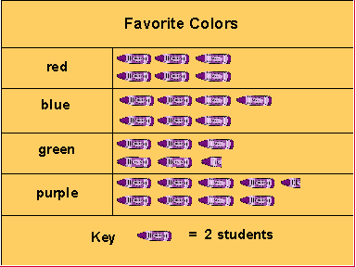
How many students does each pink crayon represent?
1 student
2 students
3 students
4 students

Slide 7
How many students favorite color is purple?
9
8
17
45

Slide 8
How many more students liked the color purple than the color blue?
3
2
1
5

Slide 9

Bar Graphs
Uses bars to show data
Used to compare counts of different categories called categorical data
This bar graph shows how much money was spent on food each week.

Slide 10
Uses parallel bars (horizontal or vertical) to represent counts for several categories
One bar is used for each category
A space is left before, between, and after the bars
These are vertical bars that represent 1 week.

Slide 11
Axis and Title on a Bar Graph
The axis displays the scale on a graph. It should extend one increment above the greatest recorded piece of data.
Each axis should be labeled, and the graph should be given a title.
Title
This is the axis.

Slide 12
Scale the Axis
The numbers that show the units used on a graph is called the scale.
The interval of the scale is 10 for this bar graph because the numbers count by 10.
This is the scale.

Slide 13
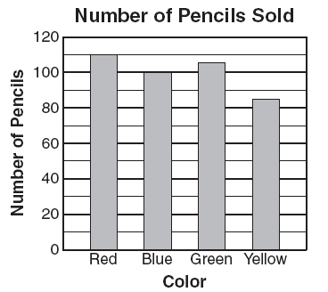
Look at this bar graph. What is the title of this bar graph?

Slide 14
How many red pencils were sold?
100
115
110
105

Slide 15
How many red and blue pencils were sold?
10
205
210
215

Slide 16
What is the interval on this graph? Look at the scale to help you.
5
10
15
20

Slide 17
How many yellow pencils were sold?
85
90
95
80

Slide 18
How many more blue pencils than yellow pencils were sold?
185
15
10
110

Slide 19
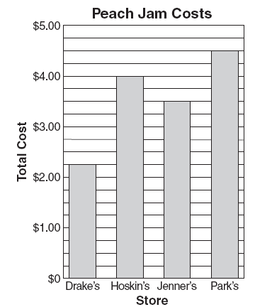
Between which two stores was there the greatest difference in total cost?
Park’s and Jenner’s
Hoskin’s and Jenner’s
Drake’s and Park’s
Jenner’s and Park’s

Slide 20
Line Graphs
Shows how variables (things) change over time (increases, decreases, or stays the same)
Line graphs connect points together to show how the data has changed over time

Slide 21
Values along the horizontal axis represent data on a given variable, usually some measure of time (e.g., time in years, months, or days
Horizontal axis

Slide 22
Values along the vertical axis are the scale and represent the frequency (how often) with which those values occur in the data set.
Vertical axis

Slide 23
Values on the vertical axis should represent equal increments. The scale should extend at least one increment above the greatest recorded piece of data.
The greatest recorded data.
This is the scale. The interval is 5 because it counts by 5s. The scale extends beyond the greatest recorded data.

Slide 24
Each axis on a line graph should be labeled, and the graph should be given a title.
Line graphs tell whether something has increased, decreased, or stayed the same over time
The title for the line graph.
Labels for the horizontal and vertical axis.

Slide 25
About how high was the liquid in the tank at 8:00 a.m.?
20 feet
24 feet
20 inches
24 inches

Slide 26
How high was the liquid in the tank at 11:00 a.m.?
25 feet
20 feet
25 inches
20 inches

Slide 27
At what time was the liquid in the tank at its highest point?
8:00 a.m.
10:00 a.m.
11:00 a.m.
10:00 p.m.

Slide 28
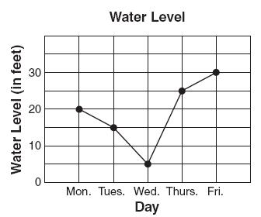
How many feet lower was the level on Wednesday than on Monday?
3 ft.
5 ft.
15 ft.
25 ft.

