Slide 1
Virginians and their Documents
VS.6

Slide 2
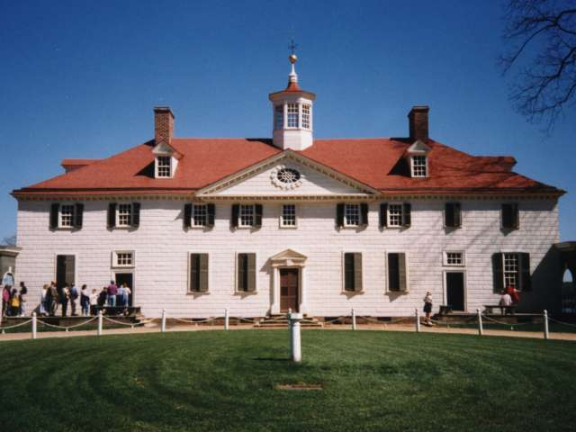
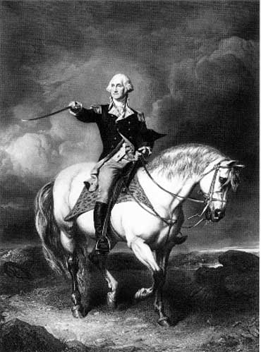
George Washington
Virginian (Mount Vernon)
http://www.youtube.com/watch?v=e2_mIqwZ0gM&feature=related&safety_mode=true&persist_safety_mode=1&safe=active

Slide 3
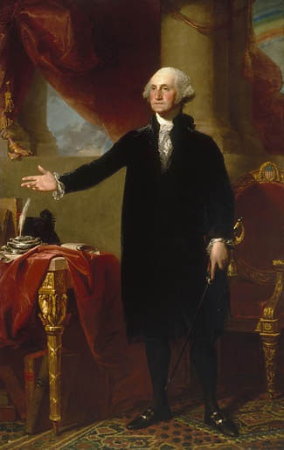
1st President of the United States
Strong leadership needed to help the young country and provided a model of leadership for future presidents.
“Father of Our Country”

Slide 4
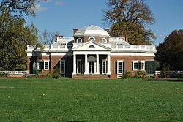
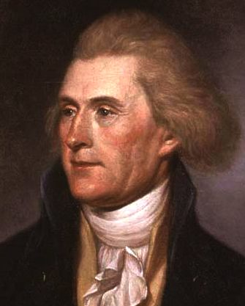
Thomas Jefferson
Virginian (Monticello)
Author of the Declaration of Independence
Author of another important document…

Slide 5
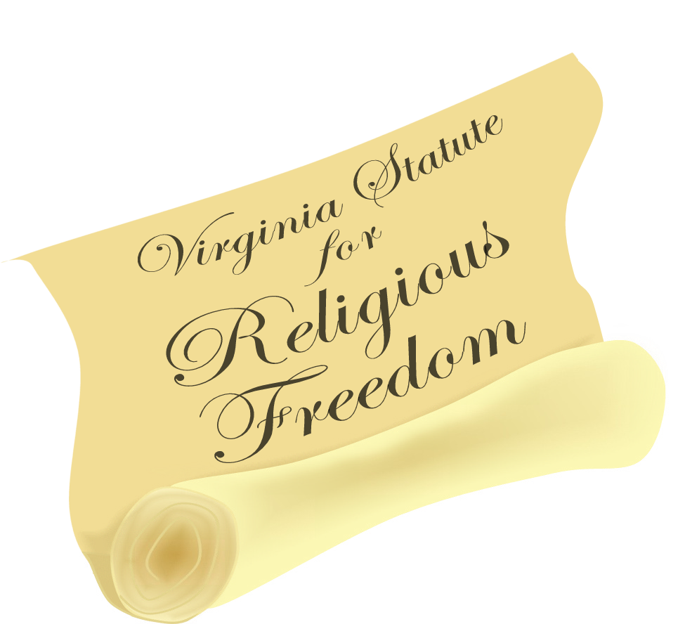
Virginia Statute for Religious Freedom
States that all people should be free to worship as they please.
This document was the basis for the First Amendment to the Constitution, the amendment that protects religious freedom.

Slide 6
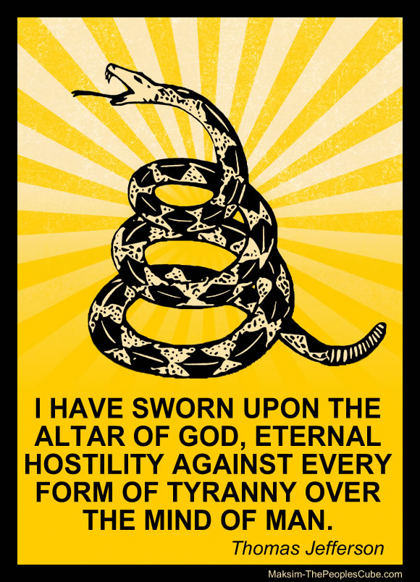
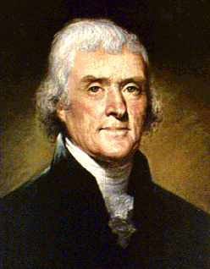
Why was it written?
After the Revolutionary War, should the government impose taxes on its citizens?
What should those taxes be used for?
Should those taxes be used to support churches?
What churches would be supported by those taxes and which churches would not?
Was this fair?

Slide 7
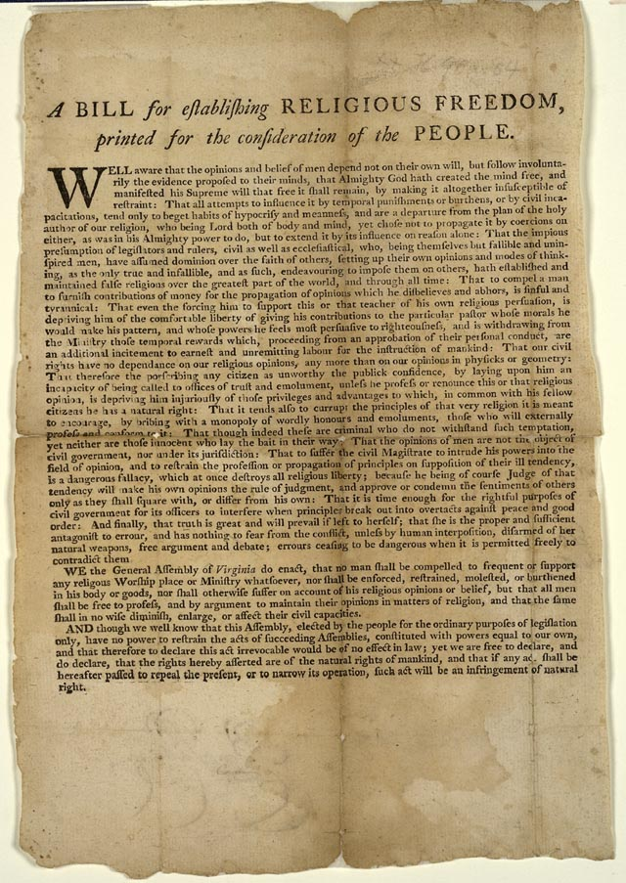
Virginia Statute for Religious Freedom
The government would not support any ONE type of church.
The government would not force people to pay taxes to their church.
The government would not force people to be religious or go to a certain type of church.

Slide 8
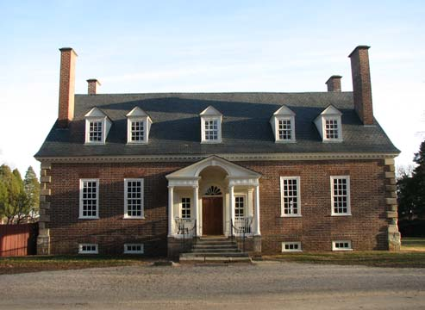
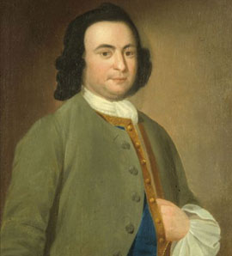
George Mason
Virginian
(Gunston Hall)
Virginia Declaration of Rights

Slide 9
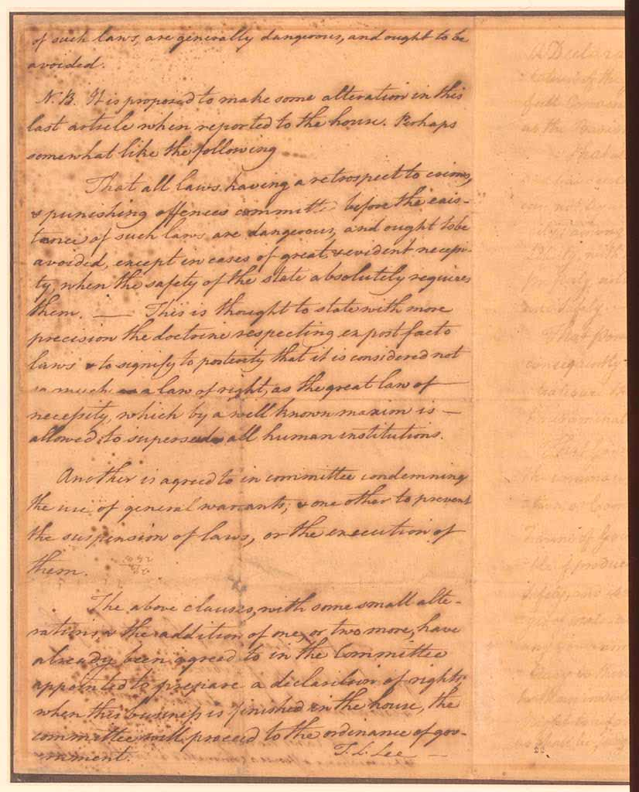
Virginia Declaration of Rights
States that all Virginians have many rights, including freedom of religion, freedom of the press, and the right to a trial by jury.
Became the basis for the Bill of Rights of the United States Constitution.

Slide 10
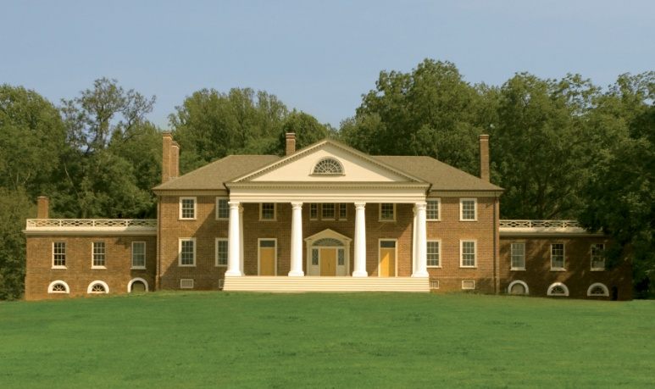
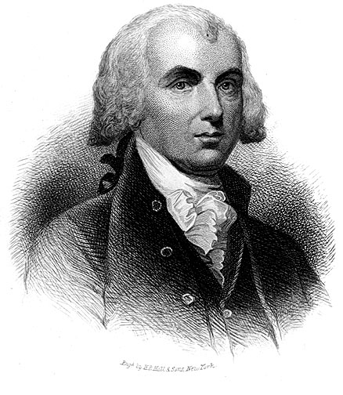
James Madison
Virginian (Montpelier)
Took detailed notes during the Constitutional Convention and wrote the Constitution
“Father of the Constitution”

Slide 11
Constitution of the United States
Tells the government what it can do and what it cannot do
Gives the power to 3 branches of government.
1. president
2. Congress (House of Reps + Senate)
3. Supreme Court
Bill of Rights (at the end of the Const.) → protects the rights of citizens

Slide 12
WHY DID VIRGINIANS MOVE TO THE WESTERN FRONTIER OF VIRGINIA AND BEYOND?
After the American Revolutionary War, Virginia’s agricultural base began to change, and as a result large numbers of Virginians moved west and to the deep South to find better farmland and new opportunities.
Agriculture = farming

Slide 13
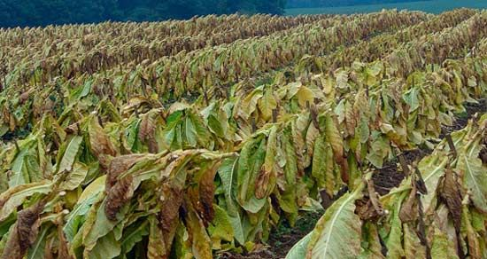
Tobacco Farming
Tobacco farming was hard on the soil, causing many farmers to look south and west for new land to farm.

Slide 14
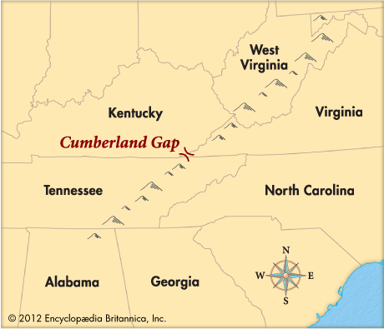
Migration
Some Virginians migrated into western territories looking for large areas of land and new opportunities.
They traveled through the Appalachian Mountains by crossing the Cumberland Gap.

Slide 15
Who was the Father of our Country?
A. James Madison
B. George Washington
C. George Mason

Slide 16
Who wrote the Declaration of Independence?
A. James Madison
B. George Washington
C. Thomas Jefferson

Slide 17
Who is known as the “Father of the Constitution”?
A. James Madison
B. George Washington
C. George Mason

Slide 18
Who said, “Give me liberty or give me death”?
A. Patrick Henry
B. George Washington
C. Thomas Jefferson

Slide 19
Who saved Thomas Jefferson’s life?
A. James Armistead Lafayette
B. Jack Jouett
C. James Madison

Slide 20
Who wrote the Virginia Statute for Religious Freedom?
A. Thomas Jefferson
B. George Washington
C. Patrick Henry

Slide 21
Who wrote the Virginia Declaration of Rights?
A. Thomas Jefferson
B. George Mason
C. George Washington

Slide 22
Who took notes during the Constitutional Convention?
A. James Madison
B. George Washington
C. George Mason

Slide 23
This document was the basis for the First Amendment to the Constitution, the amendment that protects religious freedom.
A. Declaration of Independence
B. Virginia Statute for Religious Freedom
C. Virginia Declaration of Rights

Slide 24
Whose strong leadership needed to help the young country and provided a model of leadership for future presidents?
A. George Mason
B. Thomas Jefferson
C. George Washington

Slide 25
What states that all Virginians have many rights, including freedom of religion, freedom of the press, and the right to a trial by jury?
A. Declaration of Independence
B. Virginia Statute for Religious Freedom
C. Virginia Declaration of Rights

